Slide 1
Chapter 1
Introduction

Slide 2
Introduction
Because data is so important in most organizations, computer scientists have developed a large body of concepts and techniques for storing and managing data
Data: Known facts that can be recorded and have an implicit meaning. Ex: name, mobile number, grades, temperature etc…..
What is the difference between data and information
Data that need to be stored is everywhere. In universities, supermarkets, banks, interactive voice response (IVR), etc.…..
In the early days, these applications were built directly on top of file systems

Slide 3
File Based Systems
It is a collection of application programs that perform services for the users wishing to access information. Each program defines and manages its own data.
File-based systems were an early attempt to computerize the manual filing system that we are all familiar with
The manual filing system works well while the number of items to be stored is small. It even works quite adequately when there are large numbers of items and we have only to store and retrieve them.
It is not adequate when we have to cross-reference or process the information in the files

Slide 4
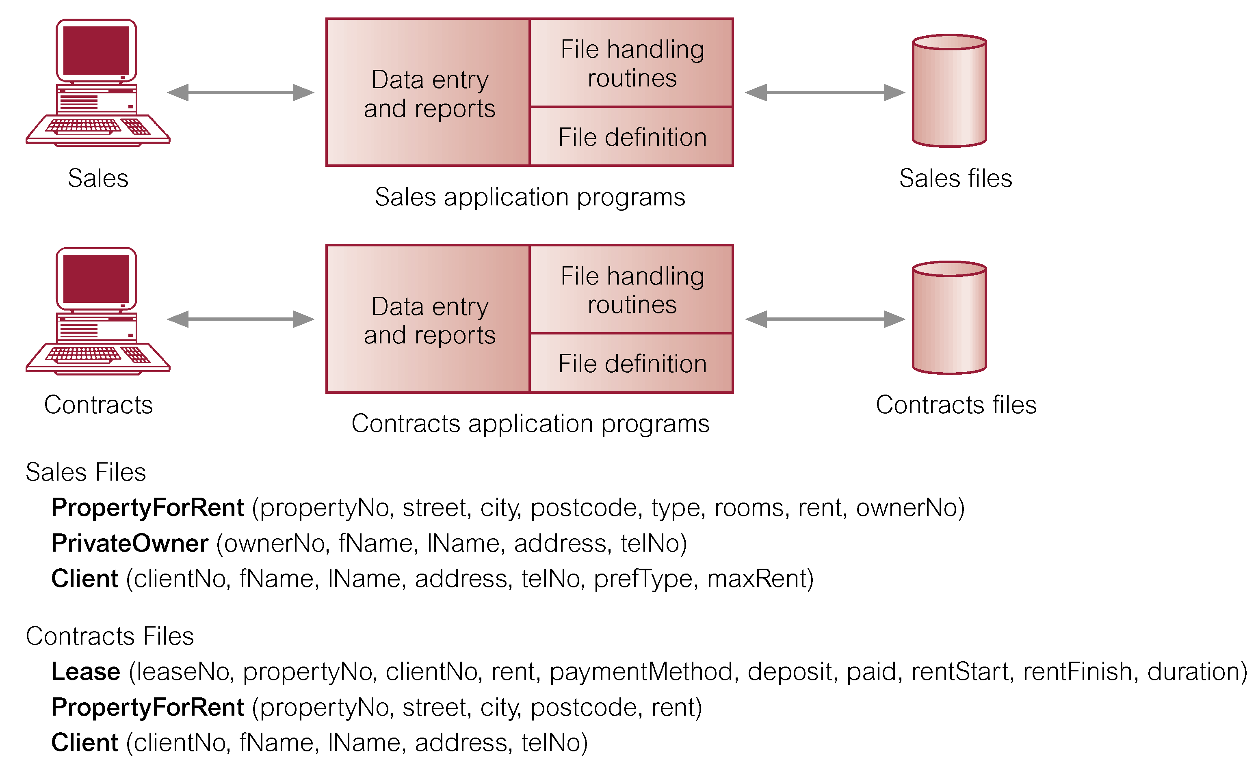
File Based Processing

Slide 5
Disadvantages of File Based Systems
Separation and isolation of data: When data is isolated and scattered in separate files and files may be in different format, it is more difficult to access needed data.
  Duplication of data: Different systems/programs have separate copies of the same data which result in:
    Wasting time and storage space to enter data twice
    Difficulty in maintenance
    Result in inconsistent data
Data Dependence: The physical structure and storage of the data files and records are defined in the application code. This means that changes to an existing structure are difficult to make

Slide 6
Disadvantages of File Based Systems (cont.)
Integrity Problem: The data values stored in files must satisfy certain types of constraints to ensure its integrity. Ex: Salary should not exceed 50.000, student ID shouldn’t be duplicated
Atomicity Problem: Transactions done must happen in its entirety or not at all. It is difficult to ensure atomicity in a conventional file based system
Security Problems: Not every user of the system should access all the stored data. Enforcing such security constraint is difficult. Also, there is no mechanism to track who did what when and where.
Limited Data Sharing: Access to the files was restricted to one user at a time
Disaster recovery: Recovery, in the event of a hardware or software failure, was limited or non-existent

Slide 7
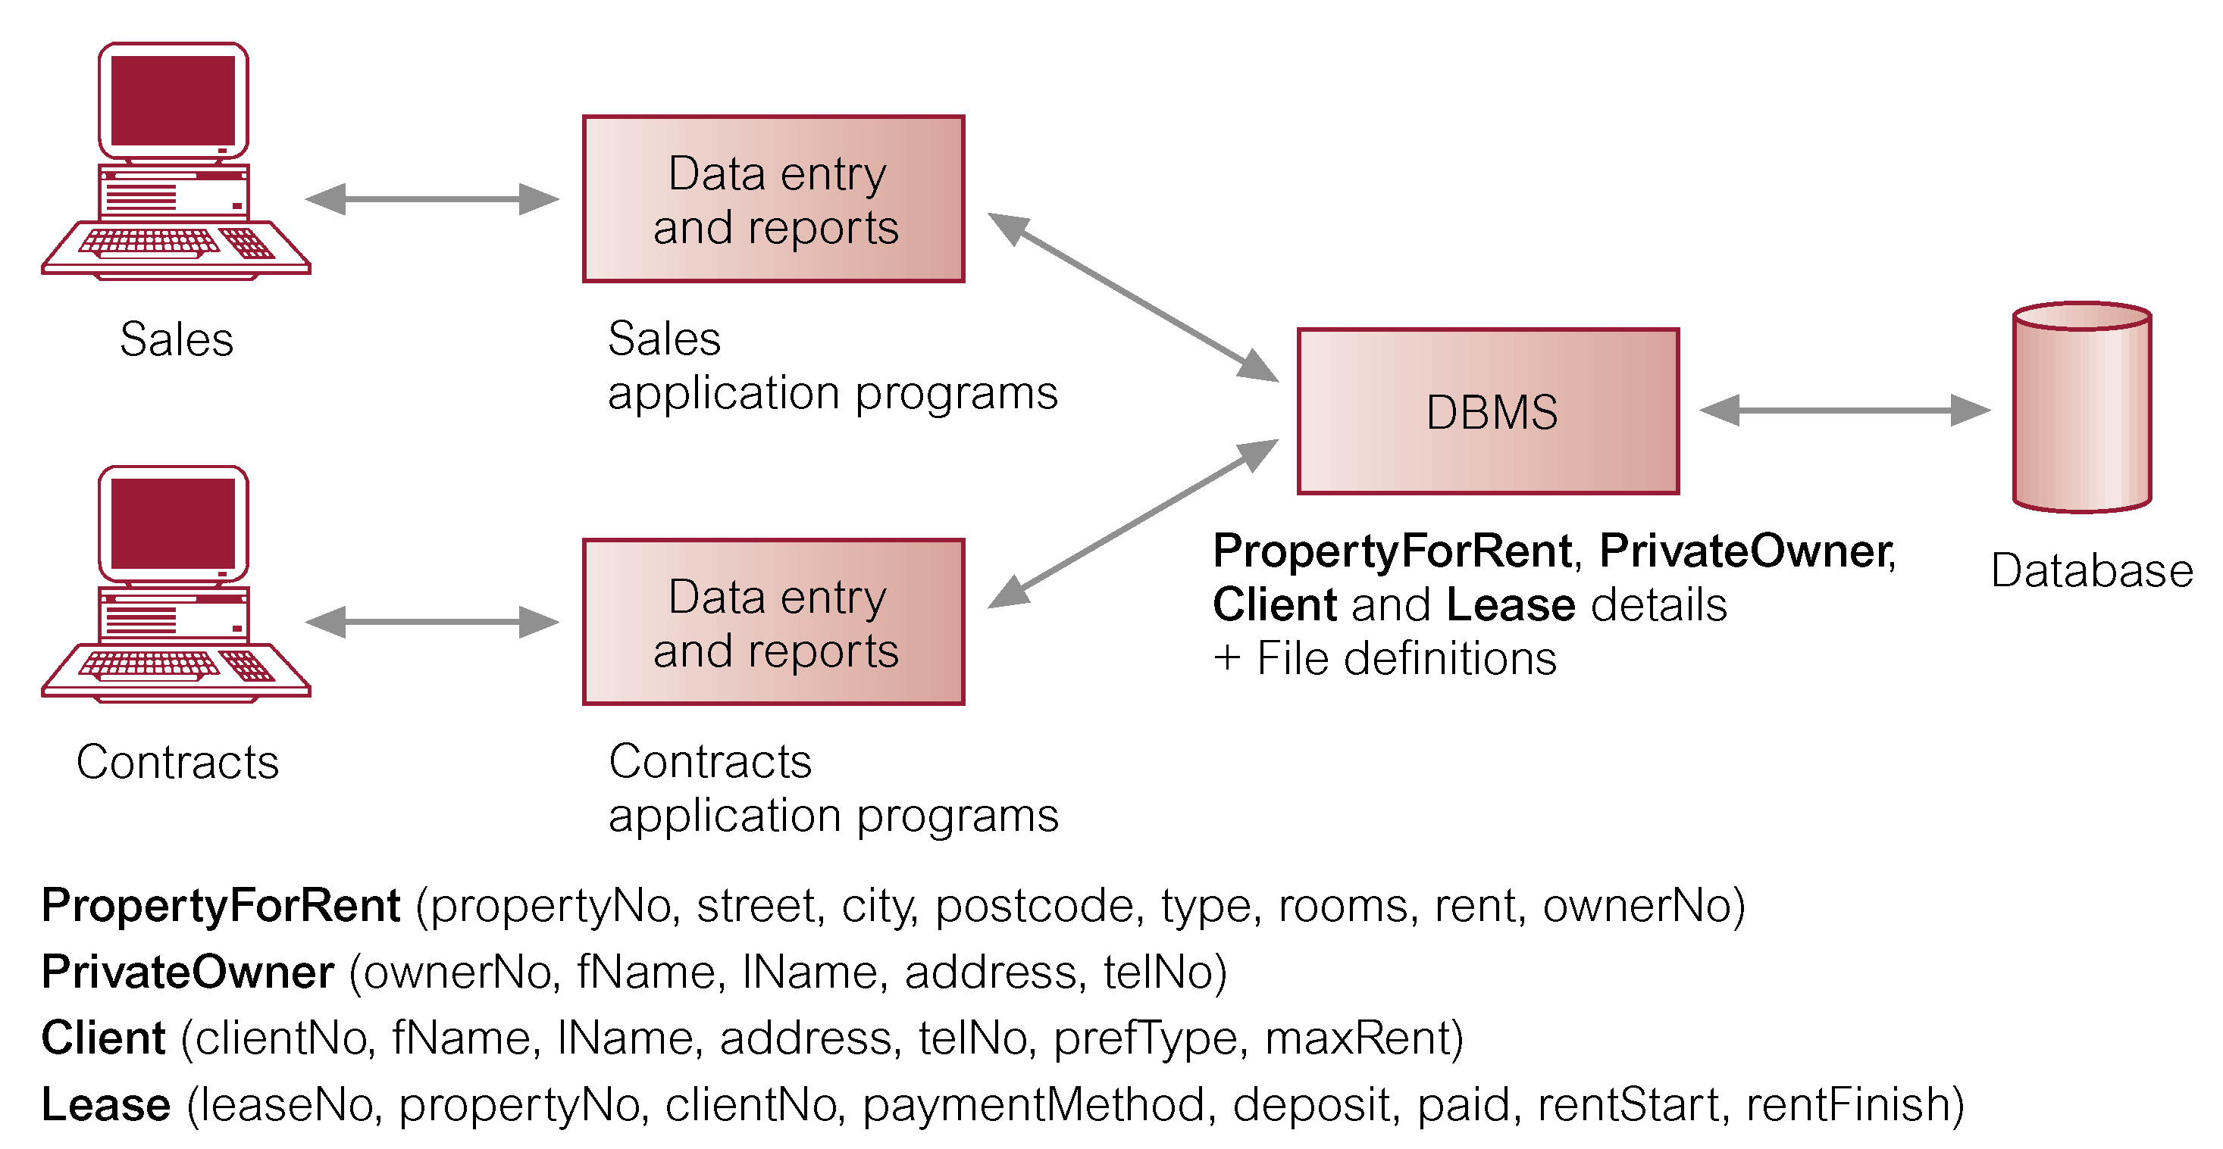
Solution: Database

Slide 8
What is Database
Database is a collection of related data
Database management system is the software that enables users to create and maintain database. It facilitates the process of defining, constructing, manipulating and sharing databases among users
Database application is a program that interacts with the database at some point in its execution
Database represents some aspect of the real world. This is called miniworld

Slide 9
DBMS Functions
Defining a database involves specifying the data types, structures and constraints of the data to be stored in the database. This definition is also stored in the database and is called meta data. This meta data is stored in what is called database catalog or dictionary.
Constructing a database is the process of storing the data on some storage medium that is controlled by the DBMS
Manipulating a database involves functions such as querying the database to retrieve data, updating the database to reflect changes in the miniworld and generating report from the data

Slide 10
DBMS Functions
Sharing a database allows multiple users and programs to access the database simultaneously
Protecting a database includes system protection against hardware or software failure and security protection against unauthorized and malicious access.

Slide 11
Database Advantages
Control of data redundancy: The database attempts to control the redundancy by integrating the files so that multiple copies of the same data are not stored
Data consistency: If a data item is stored only once in the database, any update to its value has to be performed only once and the new value is available immediately to all users
Sharing of data: data may be accessed by different users at the same time. A fundamental role of multiuser DBMS software is to ensure that concurrent transactions operate correctly and efficiently. A transaction is a process that includes one or more database accesses, such as reading or updating of database records.

Slide 12
Database Advantages (Cont.)
Improved data integrity: applying constraints to the data stored in the database to achieve data integrity become possible and easy
Support multiple view of the data: A database typically has many users, each of whom may require a different perspective or view of the database. A view is a subset of the database
Improved security: database allows the enforcement of different security measures that prevent unauthorized access to the data.
Program data independence
More information from the same amount of data
Improved backup and recovery services

Slide 13
Database Languages
There are two classes of languages:
  Procedural: user specifies what data is required and how to get those data
  Declarative (nonprocedural): user specifies what data is required without specifying how to get those data
Data Definition Language (DDL): It is the language used to specify the structure of the database (tables, attributes, data types, constraints)
Data Manipulation Language (DML): It is the language used to manipulate data in the database (insert, update, delete, retrieve)
Query: It is a statement requesting the retrieval of data

Slide 14
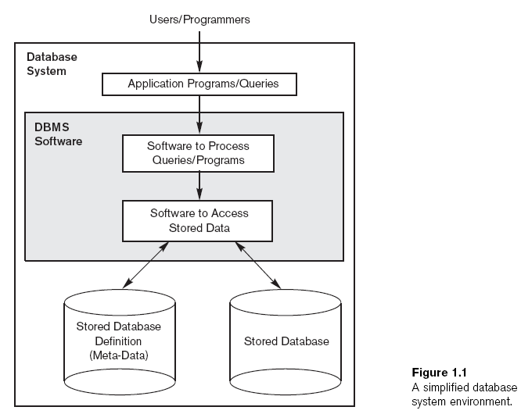
Database Environment
As Student, Dean
Teacher …
As the course registration
System
Oracle
MySql
Access

Slide 15
Database Disadvantages
Complexity: Provisioning of such functionality makes the DBMS a complex piece of software. Failure to understand the system can lead to bad design decisions, which can have serious consequences
Size: The complexity and breadth of functionality makes the DBMS an extremely large piece of software, occupying many megabytes of disk space and requiring substantial amounts of memory to run efficiently
Cost: The cost of DBMSs varies significantly, depending on the environment and functionality provided
Additional hardware cost: To achieve the required performance, it may be necessary to purchase a larger machine and additional storage space
Performance: DBs are designed to store large amount of data and accessed by many different applications The effect is that some applications may not run as fast as they used to.

Slide 16
When Not to Use DB
More desirable to use regular files for:
  Simple, well-defined database applications not expected to change at all
  Embedded systems with limited storage capacity
  No multiple-user access to data

Slide 17
An Example
University Database
  Information concerning students, courses, and grades in a university
Data Records
  Student
  Course
  Section
  Grade report
  Prerequisite

Slide 18
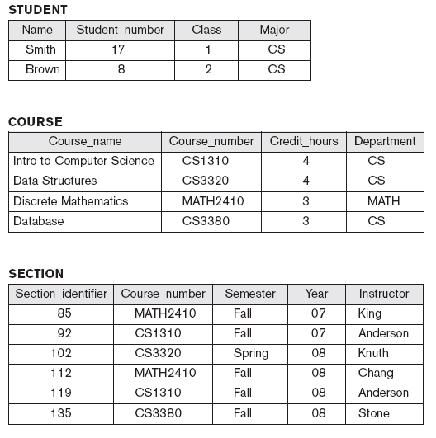

An Example

Slide 19
Database Catalog

Slide 20
An Example
In order to create the previous database, specify data types, structure and constraints
Store data in database
Query (retrieve or update) data in database

Slide 21
Database Users
Database Administrator: The DBA is responsible for authorizing access to the database, coordinating and monitoring its use, and acquiring software and hardware resources as needed. The DBA is accountable for problems such as security breaches and poor system response time
Database Designers: are responsible for identifying the data to be stored in the database and for choosing appropriate structures to represent and store this data. These tasks are mostly undertaken before the database is actually implemented and populated with data.

Slide 22
Database Users
End Users: are the people whose jobs require access to the database for querying, updating, and generating reports; the database primarily exists for their use. There are several categories of end users
Systems Analysts and Application Programmers: system analysts determine requirements for end users and interact with database designers. Application programmers develop programs that interact with the database to satisfy end users’ needs.

Slide 23
References:
Fundamentals of Database Systems, 6th edition, Elmasri, Navathe
Database_System_Concepts,_6th_Edition_korth_and_sudarshan
Database_Systems_A_Practical_Approach_to_Design,_Implementation_and_Management_4th
Good video link: https://www.youtube.com/watch?v=djEZeF4KTaM

