Slide 1
Chapter 4
Basic SQL

Slide 2
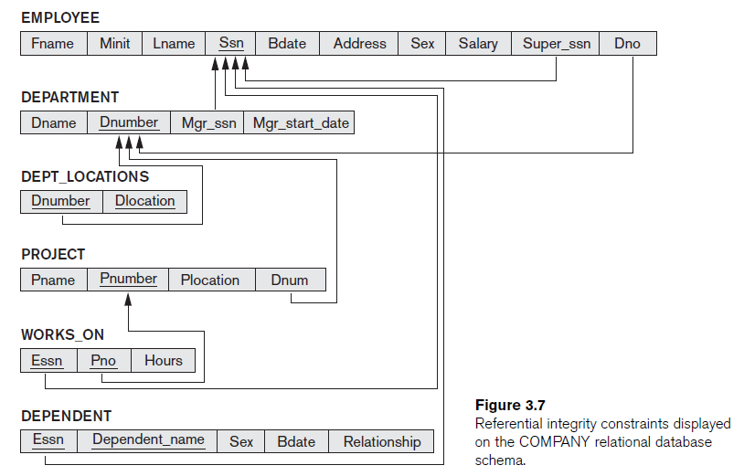
Company Database Schema

Slide 3
SQL Overview
It was originally developed by IBM in 1970
It is the standard relational database language
It stands for Standard Query Language
It is non-procedural language, you specify what information needed rather than how to get it
It has two types:
  Data Definition Language (DDL): Used it to define the structure of the database. Define database, tables, attributes, datatypes, constraints… Keywords: create, alter and drop
  Data Manipulation Language (DML): Used to manipulate data in the database. Keywords: select, update, delete and insert

Slide 4
Basic SQL Retrieval Queries Structure
Select <Attribute list>
From <Table list>
Where <Condition>
Example:
Select SSN, Fname, DOB
From Employee
Where salary > 100,000

Slide 5
Retrieve all Attributes, all Rows
Retrieve all the attributes and rows from the table:
Select * from employee
Retrieve some attributes for all employees:
Select SSN, Fname, Lname, Salary from employee
Retrieve some attributes for some employees:
Select SSN, Fname, Dnumber from employee where salary=2000
Select SSN, Fname, DOB from employee where salary=2000 and dnumber=3

Slide 6
Aliases for tables and attributes
Alias for attributes:
Select Fname as First_Name, Lname as Last_Name from Employee
Alias for Tables:
Select Fname as First_Name from employee as Emp
Attribute reference by table name:
Select employee.fname as First_name from employee
Select emp.fname from employee as emp
Notes:
Aliases are the temporary names given to table or column for the purpose of a particular SQL query. It is used when name of column or table is used other than their original names, but the modified name is only temporary. ... The renaming is just a temporary change and table name does not change in the original database

Slide 7
Ordering of the retrieved tuples
Order of resulted rows without condition
Select * from employee order by SSN
Order of resulted rows with condition
Select * from employee where salary<3000 order by SSN
Order the resulted rows with different attributes
Select SSN, Fname, address from employee order by salary, Dno
Default ordering is ascending if descending then:
Select * from employee order by salary desc
Select * from employee order by salary desc, dno asc

Slide 8
Retrieve Distinct Values
Select salary from employee (Query 1)
Select distinct (salary) from employee (Query 2)
Query 1
Salary
3000
2500
3000
3000
2500
1200
Query 2
Salary
3000
2500
1200

Slide 9
Exercises:
Retrieve project data for projects in department 10
Select * from project where dnum=10
Retrieve SSN for employees working in project number 1 with hours greater than 10 hours
Select ESSN from works_on where Pno=1 and hours> 10
Retrieve SSN and Pno for employees working in either project number 1 or 2 ordered by hours in descending way
Select ESSN, Pno from works_on where pno=1 or pno=2 order by hours desc

Slide 10
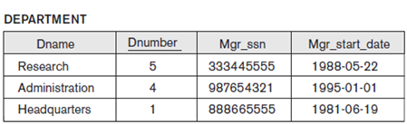
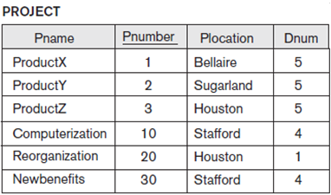
Select from Two Relations
Retrieve project name and number along with the department name controlling it
Select Pname, Pnumber,Dname from project join Department On dnumber=dnum

Slide 11
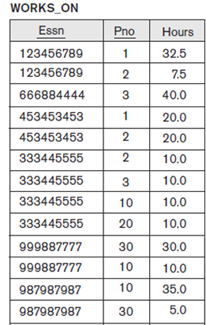
Select from Two Relations
Retrieve project name and SSN of employee working more than 10 hours in this project
Select Pname, ESSN from works_on join project on project.Pnumber=works_on.Pno where hours >10

Slide 12
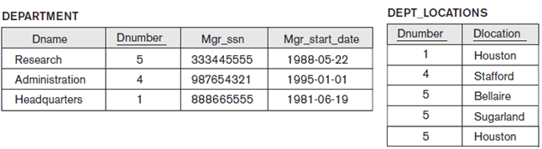
Try it Yourself …..
Retrieve each department and its location
Select Dname, Dlocation from department join dept_locations on department.dnumber=dept_locations.dnumber
Retrieve each department and its location with manager SSN= 333445555
Select Dname, Dlocation from department join dept_locations on department.dnumber=dept_locations.dnumber where mgr_ssn=333445555

Slide 13
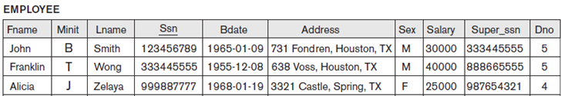
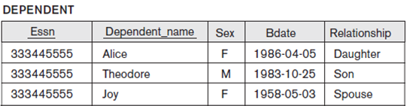
Try it Yourself …..
Retrieve employee name with his/her son or daughter data
Select Fname,Lname, dependent_name, sex, bdate, relationship from employee join dependent on ssn=essn where relationship=‘son’ or relationship=‘daughter’

Slide 14
Try it Yourself …..
Retrieve employee name and salary with his/her department name
Select Fname, Lname, salary, dname from employee join department on dno=dnumber

Slide 15
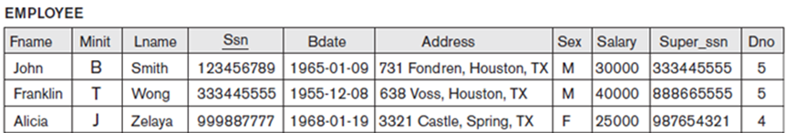
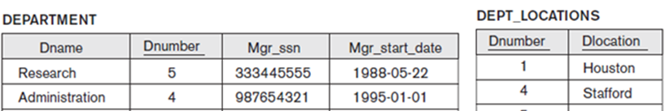
Select from Different Relations
Retrieve department name and its locations and the name of its manager with salary greater than 40000
Select Dname, dlocation,Fname+lname as manager_name from employee join department on ssn=mgr_ssn join dept_locations on department.dnumber =dept_locations.dnumber where salary> 40000

Slide 16
What is the difference between unique constraint and primary key
Explain what is meant by referential integrity
Notes:
The difference between a UNIQUE constraint and a Primary Key is that per table you may only have one Primary Key but you may define more than one UNIQUE constraints.
Primary Key constraints are not nullable BUT UNIQUE constraints may be nullable

