Slide 1
Chapter 15
Normalization for Relational Database

Slide 2
Data Normalization
Primarily a tool to validate and improve a logical design so that satisfies certain constraints that avoid unnecessary duplication of data
The process of decomposing relations with anomalies to produce smaller, well-structured relations

Slide 3
Well-Structured Relations
A relation that contains minimal data redundancy and allows users to insert, delete, and update rows without causing data inconsistencies
Goal is to avoid anomalies
  Insertion Anomaly–adding new rows forces user to create duplicate data
  Deletion Anomaly–deleting rows may cause a loss of data that would be needed for other future rows
  Modification Anomaly–changing data in a row forces changes to other rows because of duplication
General rule of thumb: A table should not pertain to more than one entity type

Slide 4
Example
EmpID | Name | Salary | Course# | CourseTitle | Date
100 | Alaa | 32000 | 459 | SPSS | 9/9/2016
100 | Alaa | 32000 | 876 | Surveys | 7/8/2016
140 | Atheer | 40000 | 333 | Visual Basic | 1/1/2016
150 | Aisha | 23000 | 459 | SPSS | 9/9/2016
150 | Aisha | 23000 | 901 | C++ | 12/8/2016
140 | Atheer | 40000 | 901 | C++ | 12/8/2016
Is this a relation?
Yes: Unique rows and no multivalued attributes
What’s the primary key?
Composite: Emp_ID, Course#

Slide 5
Anomalies in this Table
Insertion–can’t enter a new employee without having the employee take a class. In addition, adding course for existing employee duplicate employees’ data and course data
Deletion–if we remove employee 140, we lose information about the existence of a Visual Basic class
Modification–giving a salary increase to employee 100 forces us to update multiple records
Why do these anomalies exist?
  Because there are two themes (entity types) in this one relation. This results in data duplication and an unnecessary dependency between the entities

Slide 6
Functional Dependency
Functional dependency, denoted by
X Y between two sets of attributes X, Y means that value of Y is determined by the value of X.
The value of the X of a tuple uniquely (or functionally) determine the value of Y
Y is functionally dependent on X
Notes:
National ID = Name
Project_Number = Project_Name, Project_Location

Slide 7
Functional Dependency (2)
Ssn→Ename
The value of an employee’s Social security number uniquely determines the employee name
Pnumber →{Pname, Plocation}
The value of a project’s number (Pnumber) uniquely determines the project name and location
{Ssn, Pnumber}→Hours
A combination of Ssn and Pnumber values uniquely determines the number of hours the employee currently works on specific project

Slide 8
Normal Forms Based on Primary Key
Most practical relational design projects take one of the following two approaches:
  Perform a conceptual schema design using a conceptual model such as ER or EER and map the conceptual design into a set of relations
  Design the relations based on external knowledge derived from an existing implementation of files or forms or reports

Slide 9
Normalization of Relations
The normalization process takes a relation
schema through a series of tests to certify whether it satisfies a certain normal form.
There are three normal forms, which are first, second, and third normal form
It is a purifying process that makes the design have better quality and minimizes redundancy

Slide 10
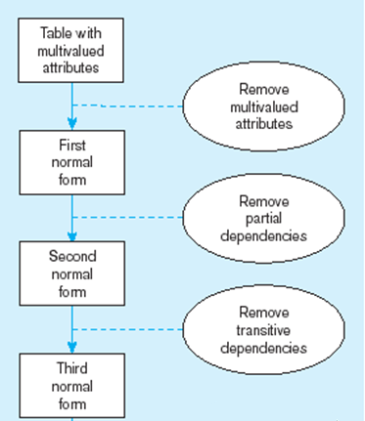
Normalization Steps

Slide 11
First Normal Form
For a relation to be in 1st normal form, redundant groups or multivalued attributes should be removed
To change to 1NF:
  Remove nested relation attributes into a new relation
  Propagate the primary key into it
Notes:
No multivalued attributes
No Campsites
No nested relations (repeating groups)

Slide 12
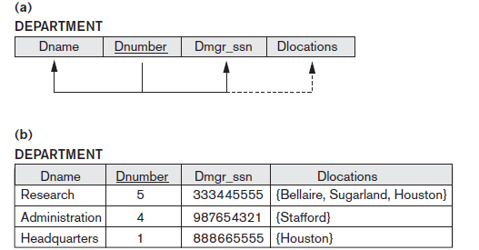
Removing multivalued attributes
New relation to be in 1st normal form
Dnumber | Dlocations
Notes:
If there are multivalued attributes (Dlocations) , we create a new table that has the PK of original table (Dnumber) + multivalued attributes (Dlocations)

Slide 13
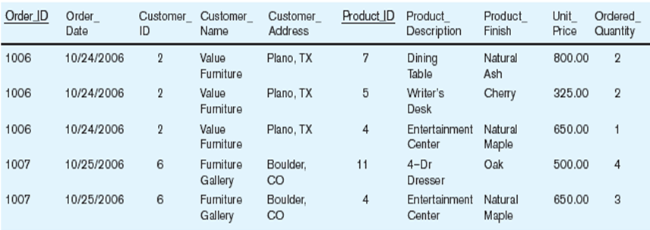
Example Nested Relations (Repeating Groups)

Slide 14
Example Nested Relations (Repeating Groups)
St_code | St_name | Address | Age | C# | C_name | Hours
20111 | Karim | Haram | 18 | DS34 | Data Str. | 3
 |  |  |  | OR23 | Ope. Rese | 3
 |  |  |  | DB12 | Database | 3
20112 | Mona | Mania | 17 | N22 | Network | 2
 |  |  |  | OR23 | Ope. Rese | 3
 |  |  |  | Db12 | Database | 3
 |  |  |  | DS34 | Data Str. | 3
Notes:
nested relations (repeating groups)

Slide 15
Example Nested Relations (Repeating Groups)
St_code | St_name | Address | Age | C# | C_name | Hours
20111 | Karim | Haram | 18 | DS34 | Data Str. | 3
20111 | Karim | Haram | 18 | OR23 | Ope. Rese | 3
20111 | Karim | Haram | 18 | DB12 | Database | 3
20112 | Mona | Mania | 17 | N22 | Network | 2
20112 | Mona | Mania | 17 | OR23 | Ope. Rese | 3
20112 | Mona | Mania | 17 | Db12 | Database | 3
20112 | Mona | Mania | 17 | DS34 | Data Str. | 3
Notes:
nested relations (repeating groups)

Slide 16
To Be in First Normal Form
The previous data to be in 1st normal form, split the repeating group in another table with the primary key of the relation to be as foreign key in the new relation
St_code | St_name | Address | Age
St_code | C# | C_name | Hours
Notes:
C# is unique in the repeating group so it became part of the PK in the new table

Slide 17
Second Normal Form
Based on concept of full functional dependency
  Versus partial dependency- Remove partial dependency
Second normalize into a number of 2NF relations
  Nonprime attributes are associated only with part of primary key on which they are fully functionally dependent

Slide 18
Second Normal Form (2)
SSN | P# | Hours | Ename | Pname | Plocation
Ename is functionally dependent on SSN only, no need for P#
Pname and Plocation are functionally dependent on P#
So this relation is not in the second normal form
Solution:
SSN | P# | Hours
SSN | Ename
P# | Pname | Plocation

Slide 19
Third Normal Form
To be in 3rd normal form you should remove transitive dependency
Non key attribute is dependent on non key attribute

Slide 20
Third Normal Form (2)
SSN | Ename | Address | Dept_code | Dept_name | Mgr_SSN
Dept_name and mgr_SSN are functionally dependent on dept_code which is non key attribute
Solution:
SSN | Ename | Address | Dept_code
Dept_code | Dept_name | Mgr_SSN

Slide 21
Exercises
Consider the following report, suppose sales order number is the primary key, normalize this report to reach better design

Slide 22
Relation
R=salesOrderNo, salesOrderDate, custNo, custName, address clerkNo, clerkName, {itemsOrdered, description, quantity, unitPrice}
To be in 1st normal form, remove repeating group (nested relations):
R1= salesOrderNo, salesOrderDate, custNo, custName, address clerkNo, clerkName
R2= salesOrderNo, itemsOrdered, description, quantity, unitPrice

Slide 23
2nd Normal Form
R1= salesOrderNo, salesOrderDate, custNo, custName, address clerkNo, clerkName
R2.1= salesOrderNo, itemsOrdered, quantity
R2.2= itemsOrdered, description, unitPrice

Slide 24
^{3rd} Normal Form
R1.1= salesOrderNo, salesOrderDate, custNo, clerkNo
R1.2= custNo, custName, address
R1.3= clerkNo, clerkName
R2.1= salesOrderNo, itemsOrdered, quantity
R2.2= itemsOrdered, description, unitPrice

Slide 25
Exercises
Al Salam Hospital - Doctor's report Date: 10/5/2004
Doctor Id. : A121 Doctor Name : Dr. Ahmed
Department Id : A Department Name : Internal Diseases
P# Pat-name Address Given Treatments
Item# Description Quantity Unit Price
10 Saleh Maadi A01 Aspirin 10 1.5
A03 Panadol 6 3.5
B01 Vitamin C 12 4.0

Slide 26
Relation
R=docId, docname, deptId, deptName,{ patient(p#,pname,address){given treatment (item#, description, quantity, unit_price)}}
First Normal Form
R1= docId, docname, deptId, deptName
R2= docId, p#, pname, address
R3=docId, p#, item#, description, qantity, unit_price

Slide 27
Second Normal Form
R1= docId, docname, deptId, deptName
R2.1= docId, p#
R2.2= p#, pname, address
R3=docId, p#, item#, qantity
R3.2= item#, description, unit_price

Slide 28
Third Normal Form
R1.1= docId, docname, deptId
R1.2=deptId, deptName
R2.2= p#, pname, address
R3=docId, p#, item#, qantity
R3.2= item#, description, unit_price

Slide 29
Exercises
Normalize the following schemas into 3rd normal form:
BRANCH (Branch#, Branch_Addr, {ISBN, Title, Author, Publisher, Num_copies})
1st Normal Form:
R1: Branch#, Branch_addr
R2: Branch#, ISBN, title, author, publisher, num_copies

Slide 30
2nd Normal Form:
R1: Branch#, Branch_addr
R2.1: Branch#, ISBN, num_copies
R2.2: ISBN, title, author, publisher
3rd Normal Form:
No change in the previous relations.

Slide 31
Exercises
Project code, project title, project manager, project budget {employeeNo, employeename,completed_hour, departmentNo, department_name, rate_per_hour}
Note: rate per hour for each employee is fixed regardless of the project. Completed hour means the number of hours employee accomplished in this project

